Slide 1
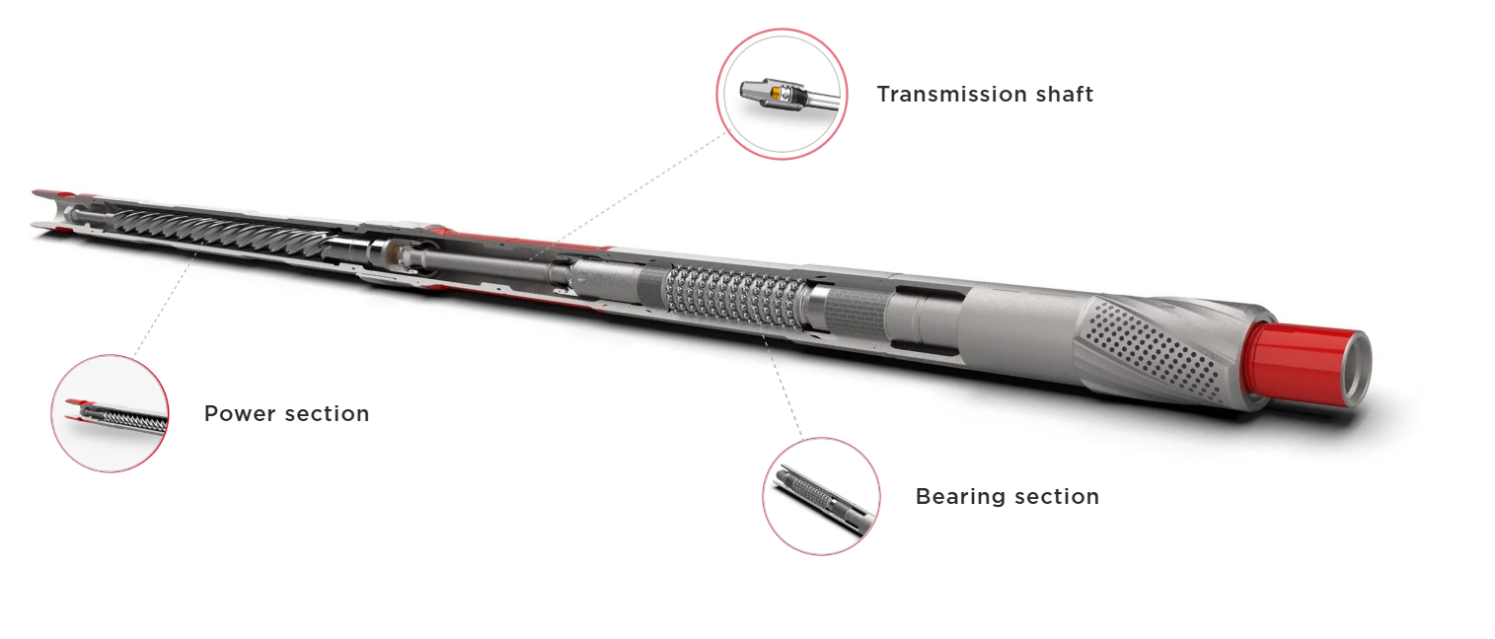
Welcome to the 5” Drillex Mud Motor
Services

Slide 2
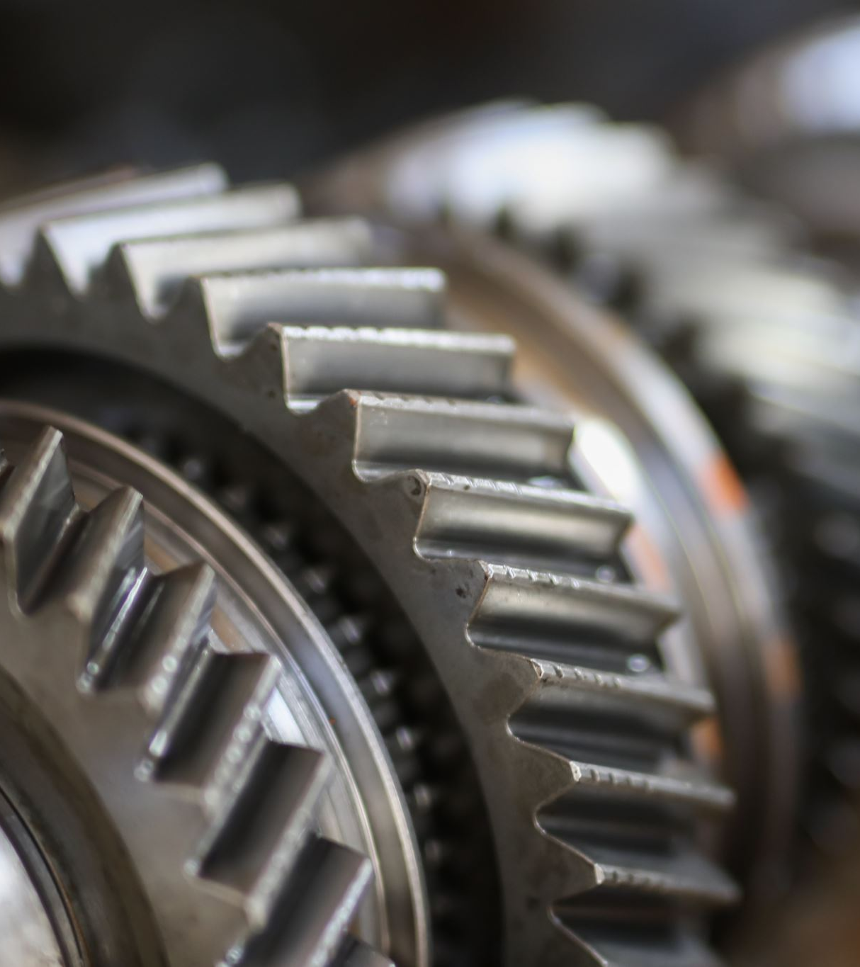
Overview
Mud motors, also known as positive displacement motors (PDMs), are essential tools in directional drilling operations. For 5-inch borehole applications, the Drillex Mud Motor prominent tool known for their durability, efficiency, and directional control.

Slide 3
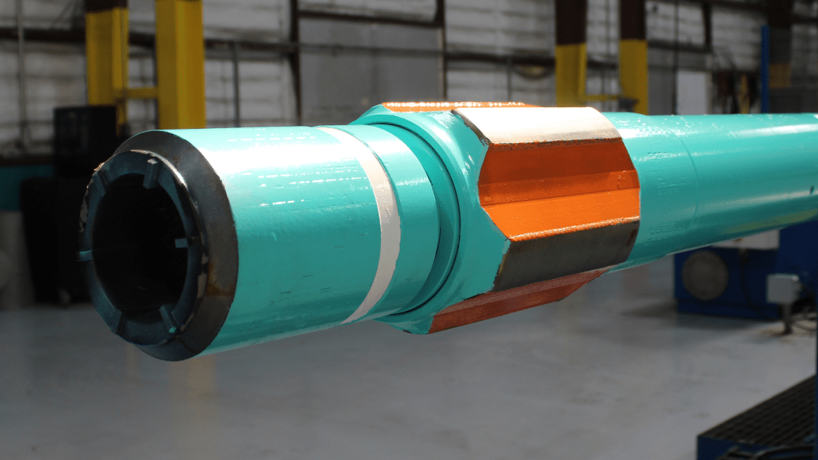
DRILL EX Mud Motor (5")

Slide 4
Manufacturer Overview
Drillex Tools is a globally recognized manufacturer of high-performance downhole drilling equipment. The company specializes in designing and engineering premium-grade Positive Displacement Motors (PDMs), power sections, and other drilling components used extensively in both conventional and unconventional well operations.
With a focus on engineering precision, rugged durability, and high adaptability, Drillex Tools has positioned itself as a leader in the field of directional and horizontal drilling technologies. Our 5-inch Drillex Mud Motor exceptional power and durability in medium to large borehole directional drilling application.

Slide 5
Mechanical and Design Features of the 5” DRILLEX Mud Motor
Power Section
  Utilizes a precision-engineered rotor-stator assembly optimized for high torque output suitable for larger diameter hole sizes.
  Employs advanced elastomer technology to withstand high-temperature and corrosive downhole fluids, allowing operation in HPHT wells.
  Lobe configurations typically range from 4:5 to 7:8, balancing torque and RPM to optimize bit performance.

Slide 6
Bearing Assembly
Features a high-strength, sealed bearing system with carbide radial and thrust bearings designed to sustain heavy axial and radial loads typical in larger boreholes.
Adjustable Bent Housing (ABH)
Bend angles adjustable up to 3.0°, enabling precise directional control and tight-radius curve capability.
Motor Length and Modularity
The motor is designed with a modular architecture, allowing efficient field servicing and quick replacement of components.
Offers both mud-lubricated and oil-filled sealed options based on well conditions and maintenance preferences.
The bit-to-bend distance is minimized to enhance steering responsiveness and reduce build section length.
Designed for longer operational life in abrasive, hard rock, and HPHT environments.

Slide 7
Design Features
High-torque performance due to enhanced rotor-stator configuration.
Adjustable bend housing for variable build rates (common range: 1–3°).
High-temperature elastomers designed for HPHT environments.
Short bit-to-bend distance for tight-radius directional control.
Improved bearing assemblies to enhance lifespan in abrasive formations.
Optional Enhancements & Add-Ons
Integration with Measurement While Drilling (MWD) and Logging While Drilling (LWD) tools.
Optional anti-drop subs and shock absorber components for enhanced BHA stability.
Custom flow diverters to optimize mud circulation and cooling.
Ideal for deep oil and gas wells, geothermal drilling, and complex horizontal sections.
Performs well in abrasive and hard formations, including carbonates and sandstone.
Suitable for HPHT wells with downhole temperatures exceeding 175°C (347°F).

Slide 8
Operational Capabilities and Advantages
Performance in High-Demand Environments
Suitable for deep directional and horizontal wells, capable of handling extended reach drilling (ERD) challenges.
Operates efficiently under high WOB (Weight on Bit) and torque demands, ensuring high ROP (Rate of Penetration).
Drilling Efficiency
Enhanced elastomer compounds and durable bearing packs reduce wear and extend run lengths.
Minimal vibration and high torque at lower RPMs improve bit stability and prolong bit life.
Versatility
Compatible with a wide range of drill bits including PDC, hybrid, and tricone.
Adaptable to multiple drilling fluid types and variable flow rates to optimize drilling performance.
Durability & Maintenance
Drillex motors are engineered for longer downhole life, reducing NPT (Non-Productive Time).
Components are field-repairable, with full support for spare parts and service kits.

Slide 9
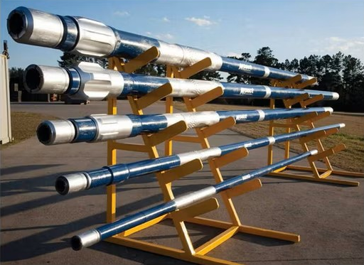
Drillex Mud Motor (5")

Slide 10
Manufacturer Overview
Drillex HDD (Horizontal Directional Drilling) is a U.S.-based manufacturer and supplier of precision-engineered tools for HDD and oil & gas directional drilling. The company is known for delivering cost-effective, durable, and innovative downhole solutions, particularly suited for utility installation, pipeline construction, and light-to-medium oilfield drilling applications.
Drillex focuses on streamlined designs, ease of maintenance, and field versatility, which makes our 5-inch mud motors especially attractive to contractors seeking high performance with minimal downtime and cost overhead. The 5-inch mud motor offers a balance of performance and economy for mid-sized borehole operations.

Slide 11
Mechanical and Design Features of the 5” DRILLEX Mud Motor
Power Section
  Available in standard and high-torque elastomer options, designed to meet various drilling conditions.
  7Lobe configurations typically include 3:4, 4:5, 6:7 and 7:8, optimizing torque for different formations.
  Suitable for moderate RPM and torque applications common in HDD and shallow directional drilling.

Slide 12
Bearing Assembly
Choice between sealed bearing packs and mud-lubricated bearings, depending on application needs.
Bent Housing Design
Fixed and adjustable bent housings available, with bend angles typically ranging up to 2.5°.
Motor Length and Compatibility
Compact design allows use in smaller rigs and tight rig floor layouts.
Bearings are modular and field-replaceable, facilitating easy maintenance and reduced downtime.
Designed to provide smooth directional build and hold profiles, important for HDD and mid-depth directional wells.
Compatible with standard HDD steering tools and some oilfield MWD systems.

Slide 13
Design Features
High-performance elastomer compatibility with a range of drilling fluids
Premium power section optimized for torque-to-speed ratio
Optional sealed or mud-lubricated bearing assemblies
Customizable bend angles for specific directional requirements
Optional Enhancements & Add-Ons
Steering tool housings for walk-over or wireline guidance.
Shock subs and vibration dampeners to improve bit and motor life.
Compatibility with downhole transmitters (sondes) for HDD navigation.
Various bit box options (API, IF) for tool interchangeability.
Suitable for mid-depth directional oil wells where moderate torque suffices.
Ideal for projects requiring cost efficiency without sacrificing reliability.
Horizontal directional drilling for utility conduits, pipeline installation, and environmental projects.

Slide 14
Operational Capabilities and Advantages
Optimized for HDD and Medium-Duty Drilling
Efficient for utility installations, pipeline crossings, and moderate-depth oilfield directional drilling.
Performs well in soft to medium-hard formations, including clay, gravel, and unconsolidated soils.
Ease of Maintenance and Cost Savings
Designed for quick rebuilds with readily available parts, enabling fast field servicing.
Minimal specialized tooling required, reducing overall service costs and downtime.
Drilling Performance
Effective torque and RPM balance for efficient mud flow and bit operation.
Suitable for flow rates typical of medium-sized rigs (50–200 GPM).
Durability
Hardened housings and protective coatings to withstand abrasive drilling fluids.
Designed to reduce premature wear in challenging soil and rock formations.

Slide 15
Summary
Feature | Drillex Mud Motor (5")
Build Rate Capability | High (up to 3.0°/100 ft)
Torque Output | Very High
Durability | Superior in abrasive/HPHT
Typical Application | Deep wells, HPHT, hard rock
Maintenance Complexity | Moderate, field-serviceable
Cost | Higher upfront investment

Slide 16
Conclusion
The 5-inch Drillex Mud Motor is engineered for high-demand drilling environments, providing exceptional torque, durability, and precision needed for deep, abrasive, and HPHT wells.
Conversely, the 5-inch Drillex Mud Motor offers a cost-effective and reliable solution tailored for HDD and mid-depth directional drilling, where ease of maintenance and operational economy are prioritized.

Slide 17
Thank You For Staying With Us
Have A Nice Day and Work Safe

